Slide 1

Course Navigation Guide
A step-by-step guide to begin and complete an assigned course

Slide 2
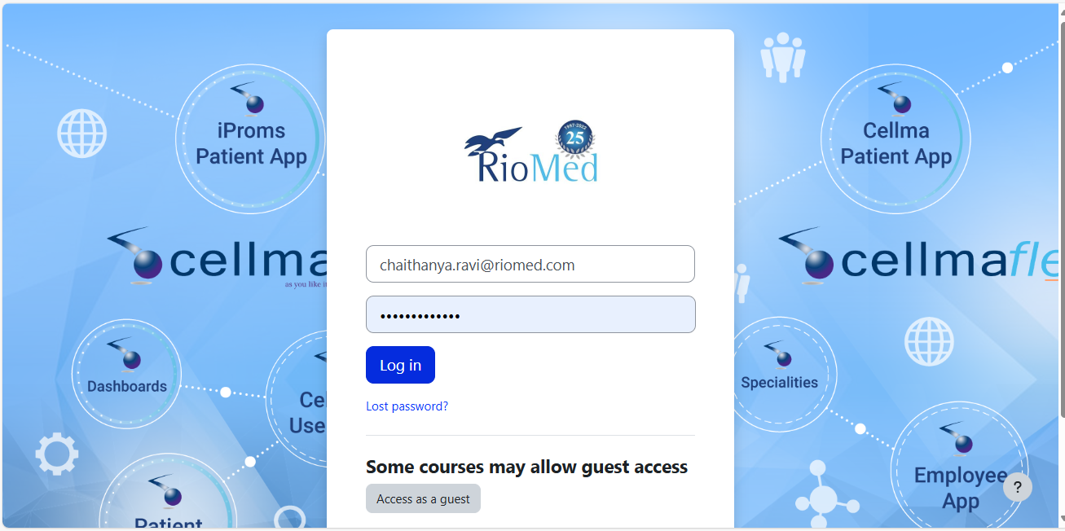
Login Page

Slide 3
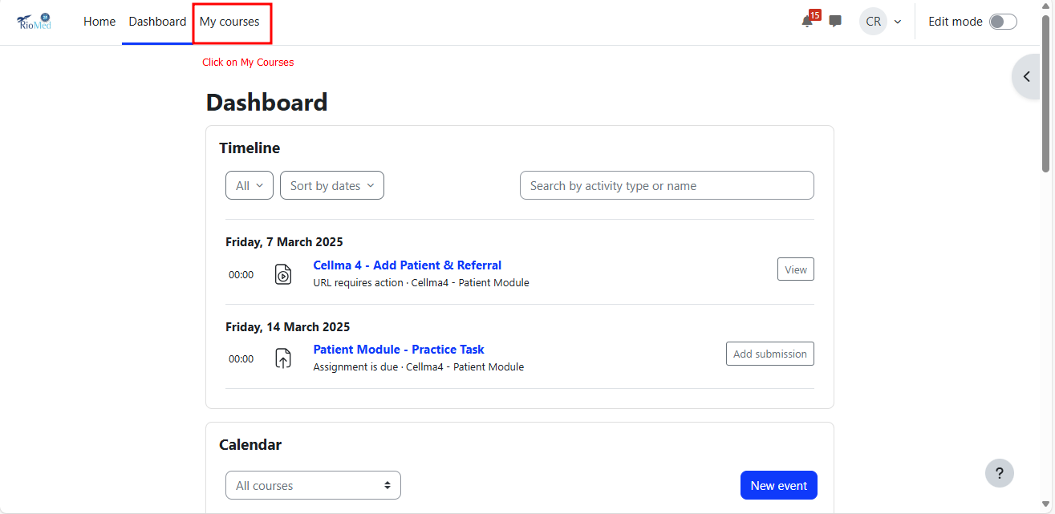
My Courses

Slide 4
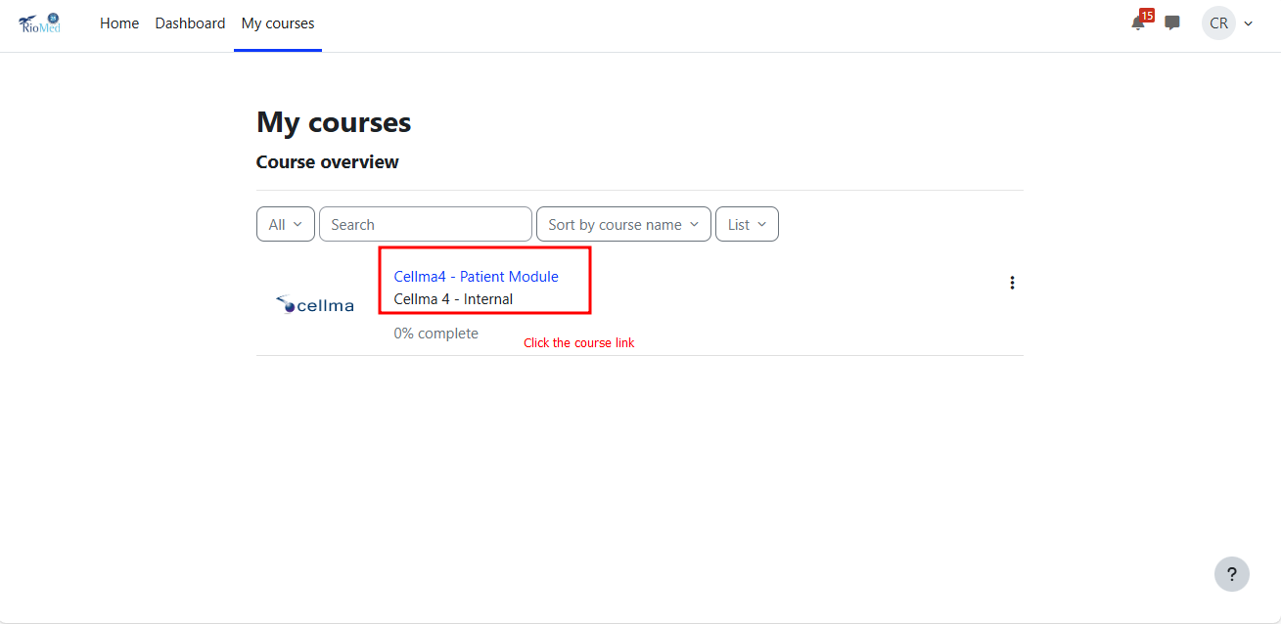
Course Link

Slide 5
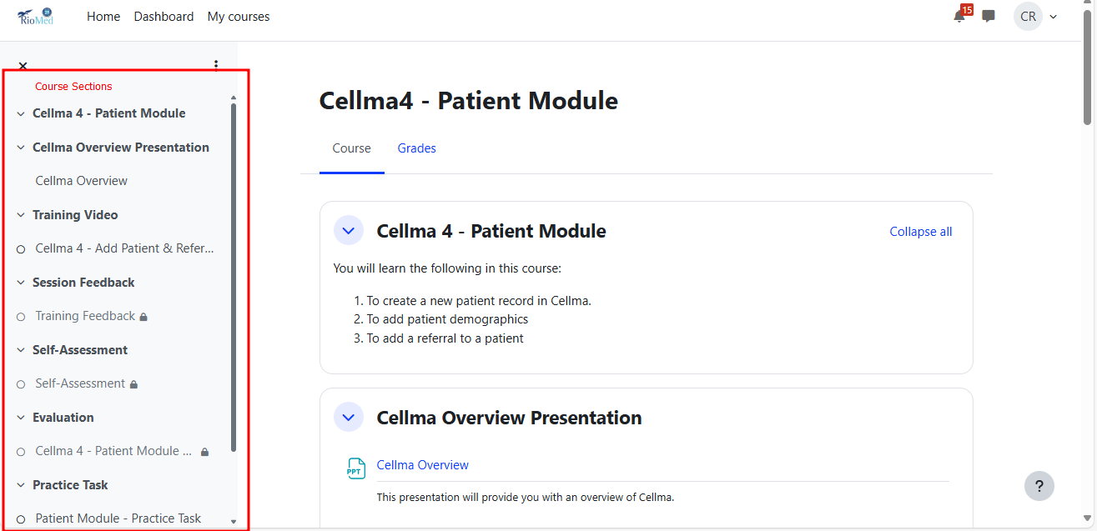
Course Sections

Slide 6
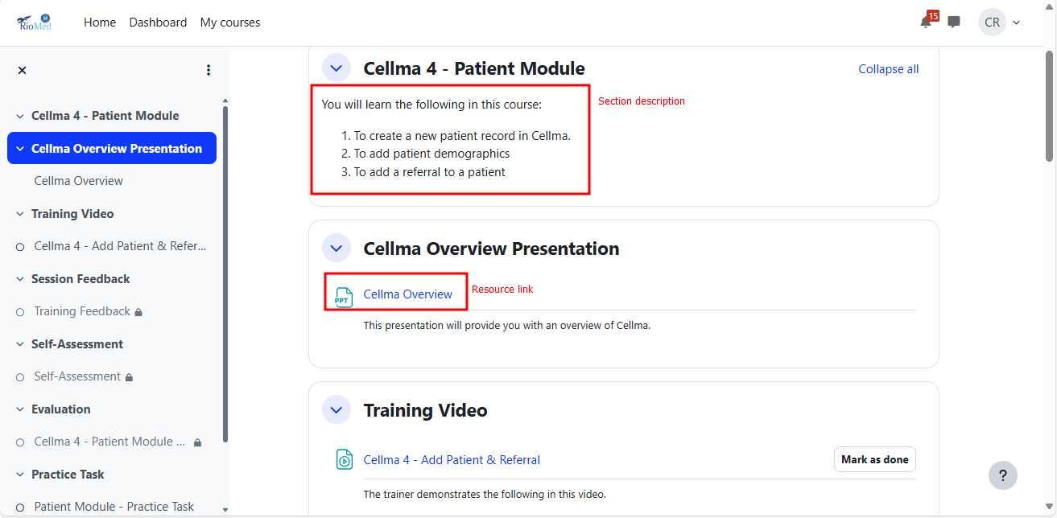
Section Description

Slide 7
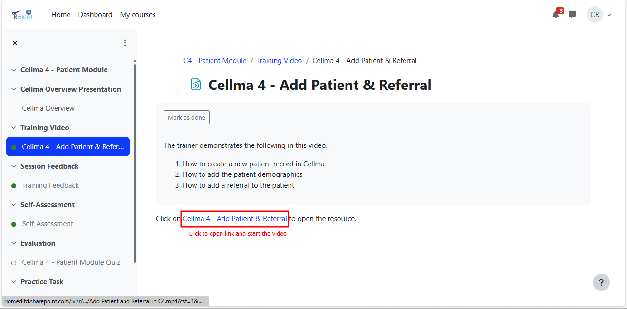
Link to Training Resource

Slide 8
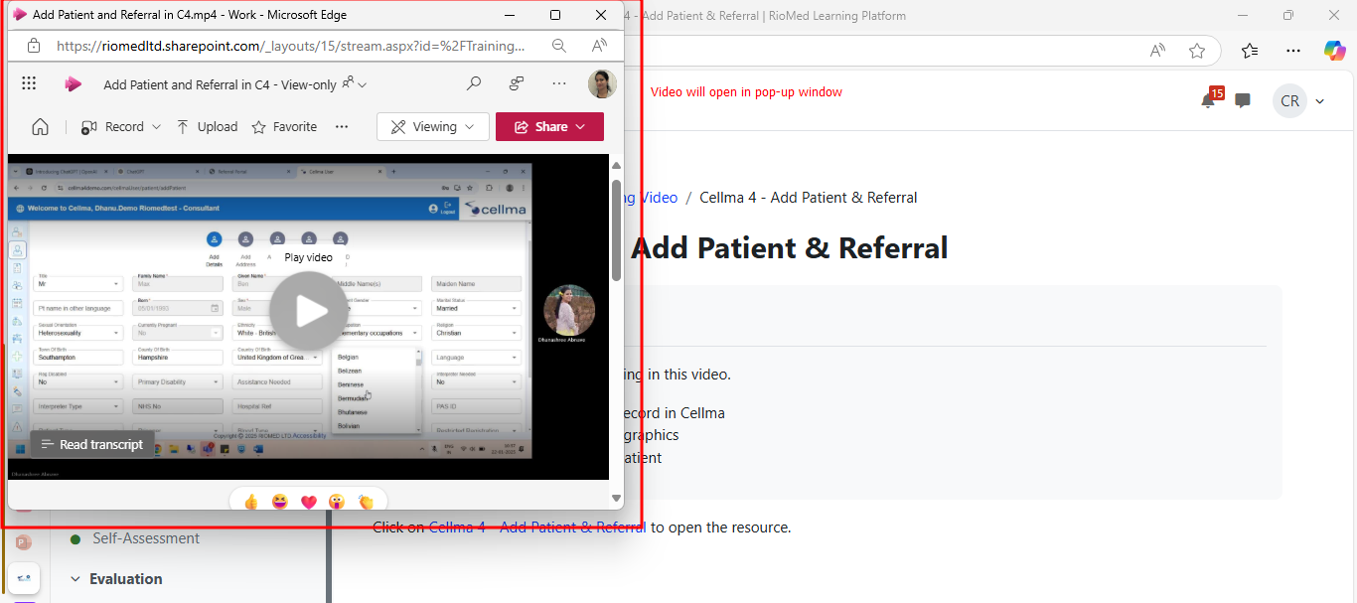
Video Pop-up

Slide 9
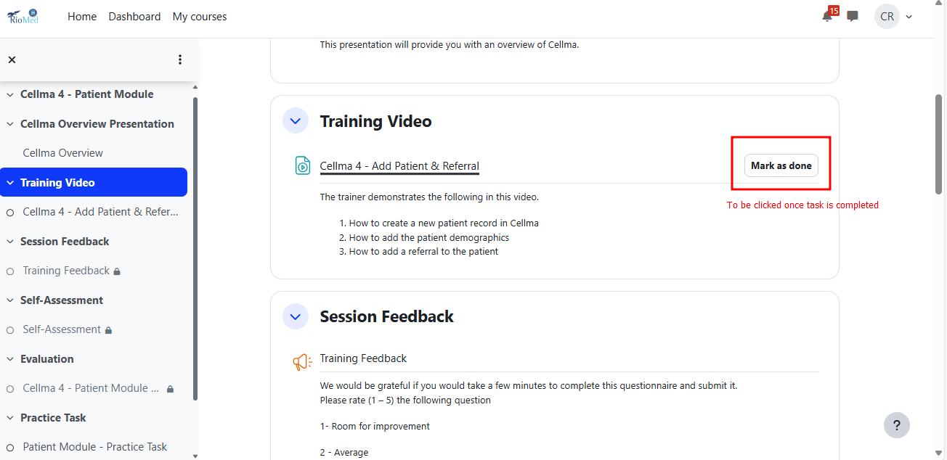
Mark Section as Done

Slide 10
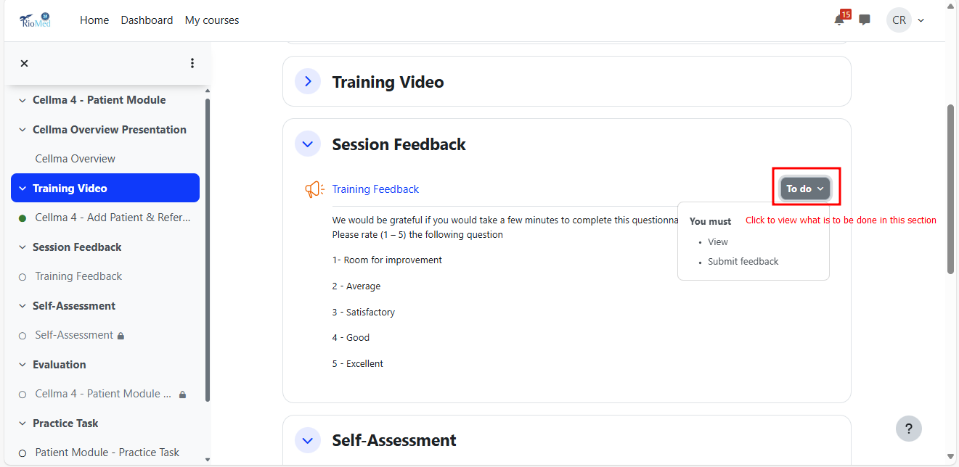
To-do Dropdown

Slide 11
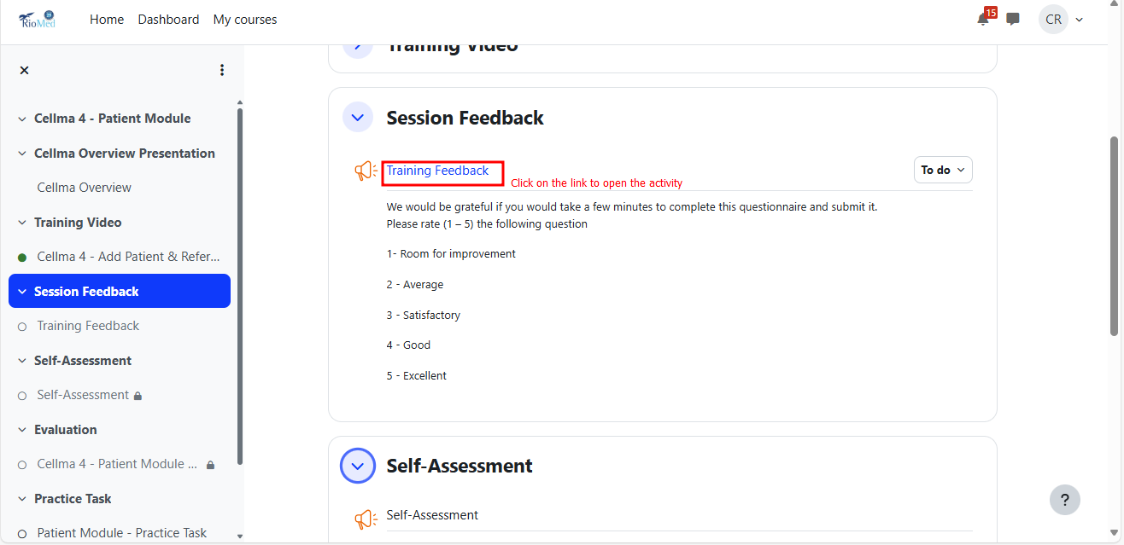
Training Feedback Link

Slide 12
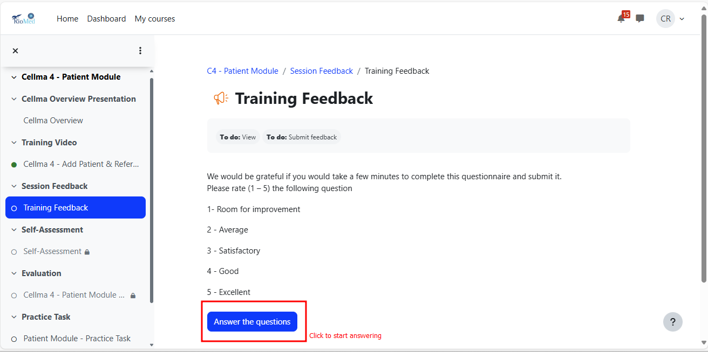
To Start Answering

Slide 13
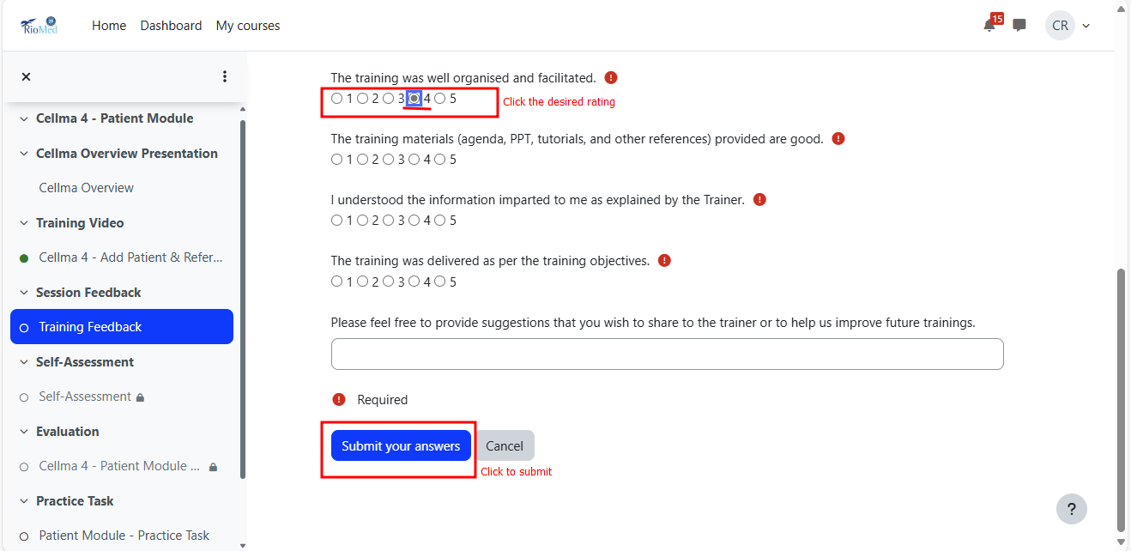
Choose Rating & Submit

Slide 14
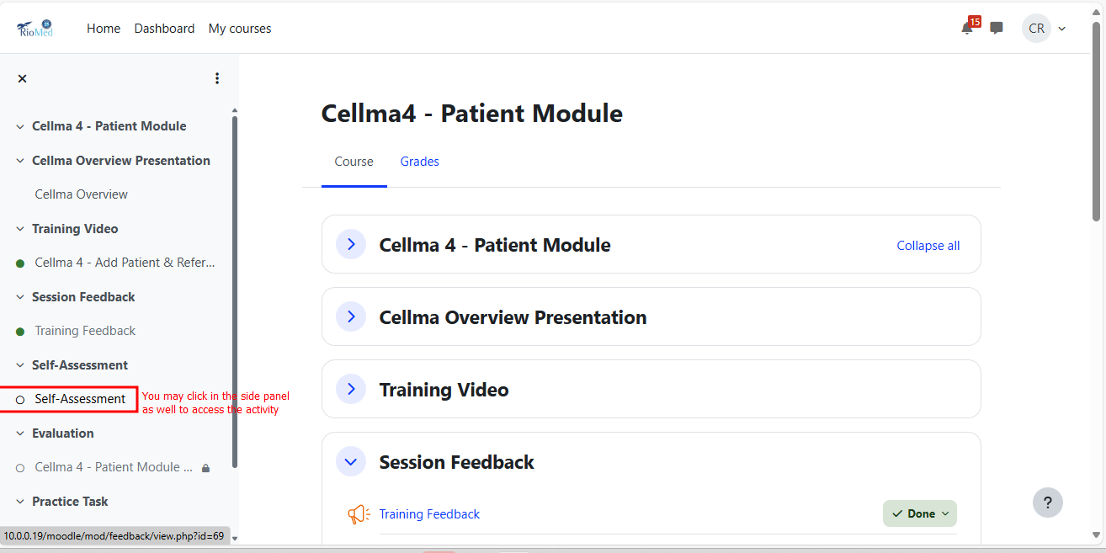
Access Link from Course Sections

Slide 15
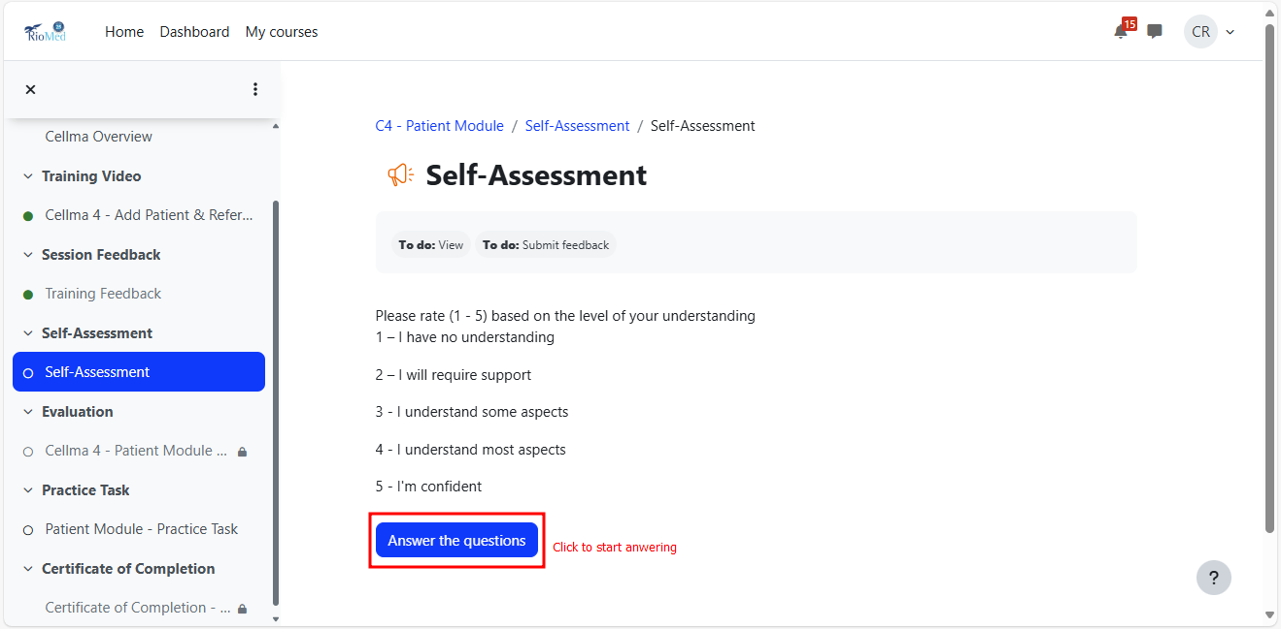
Answer the Questions

Slide 16
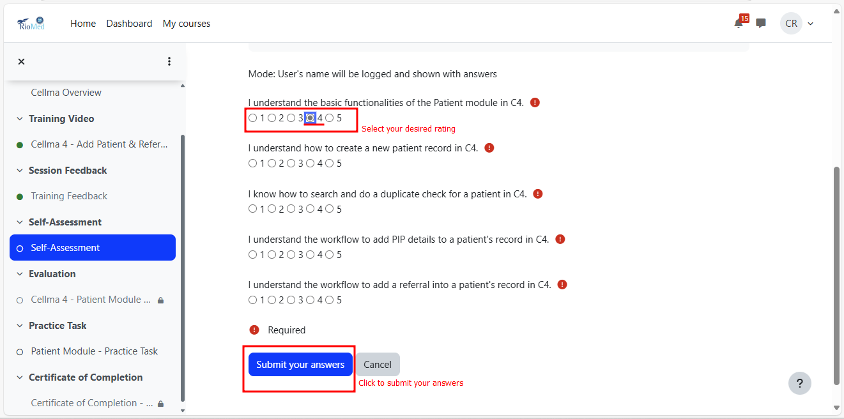
Submit your Answers

Slide 17
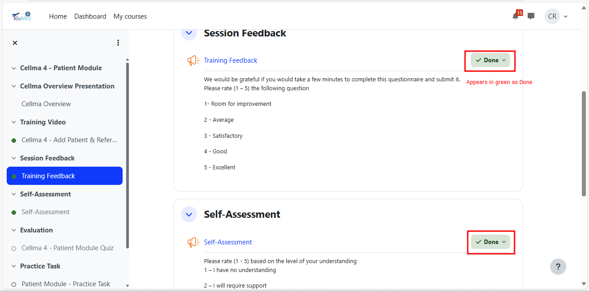
Section Completion Indication

Slide 18
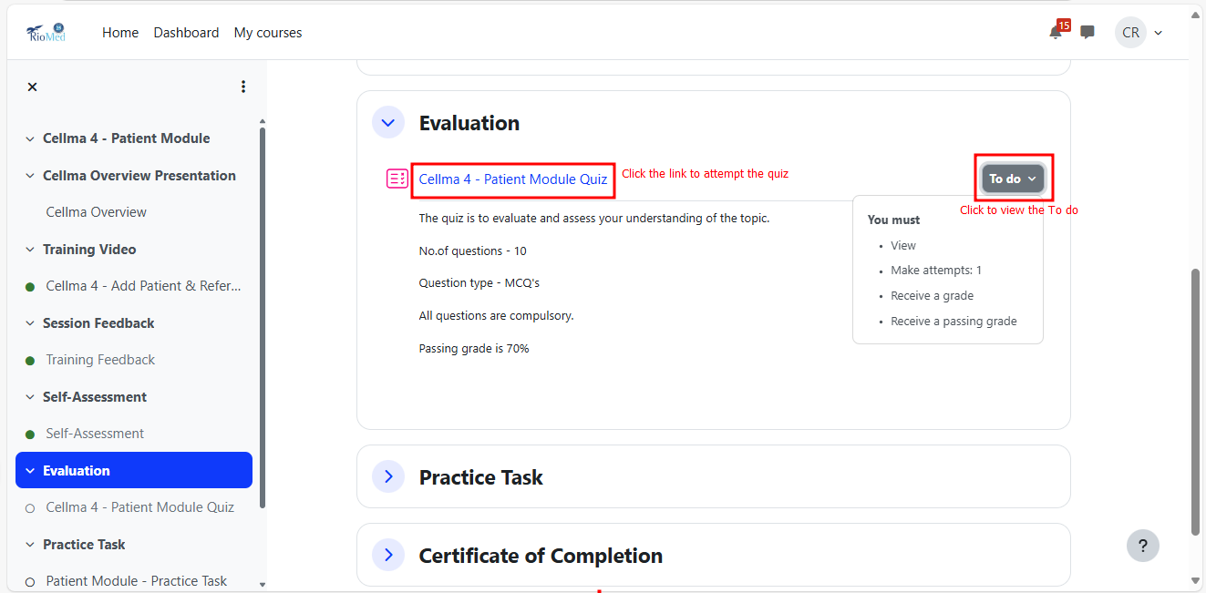
Quiz Link & To-do

Slide 19
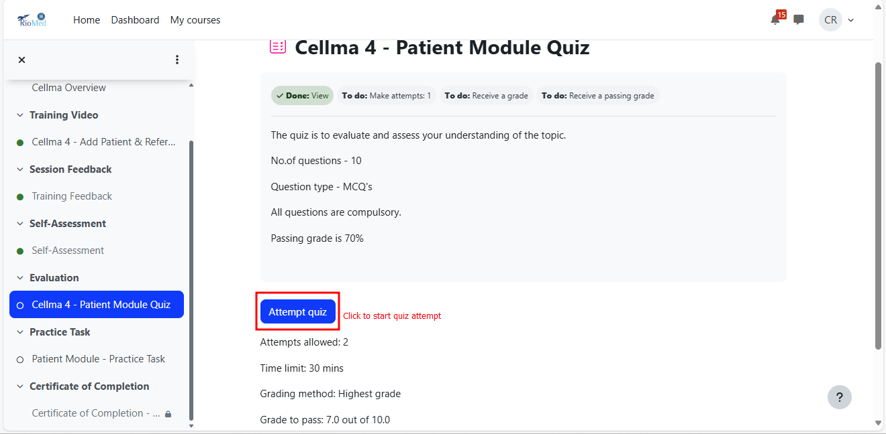
Attempt Quiz

Slide 20
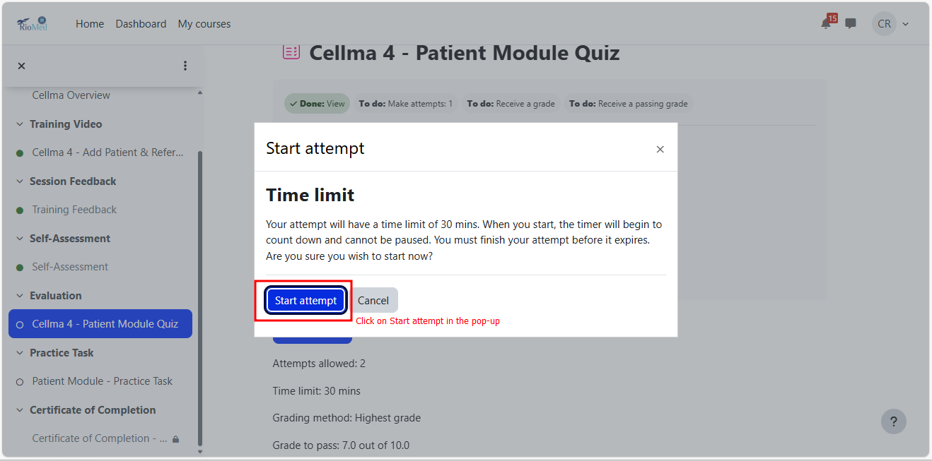
Attempt Quiz

Slide 21
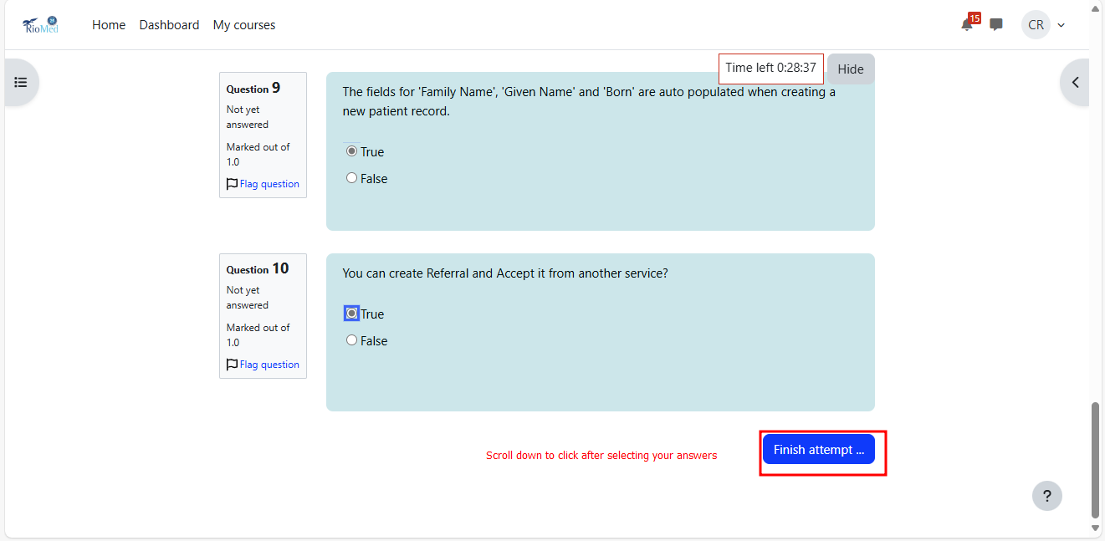
Finish Attempt

Slide 22
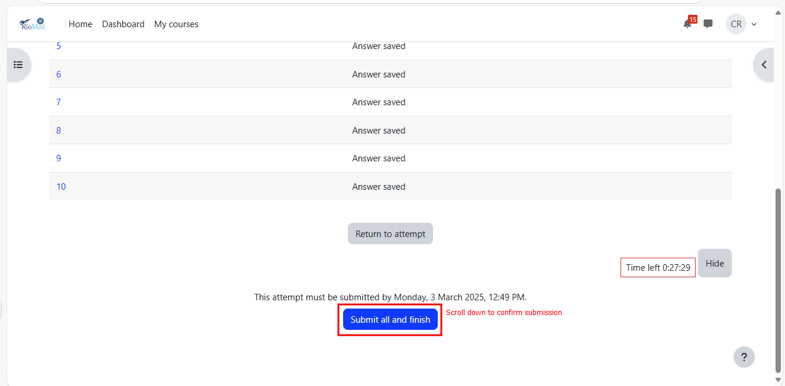
Submit Quiz

Slide 23
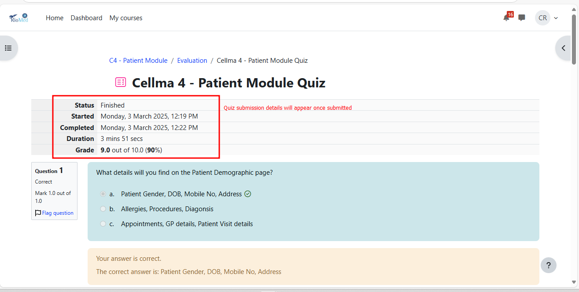
Quiz Submission Details

Slide 24
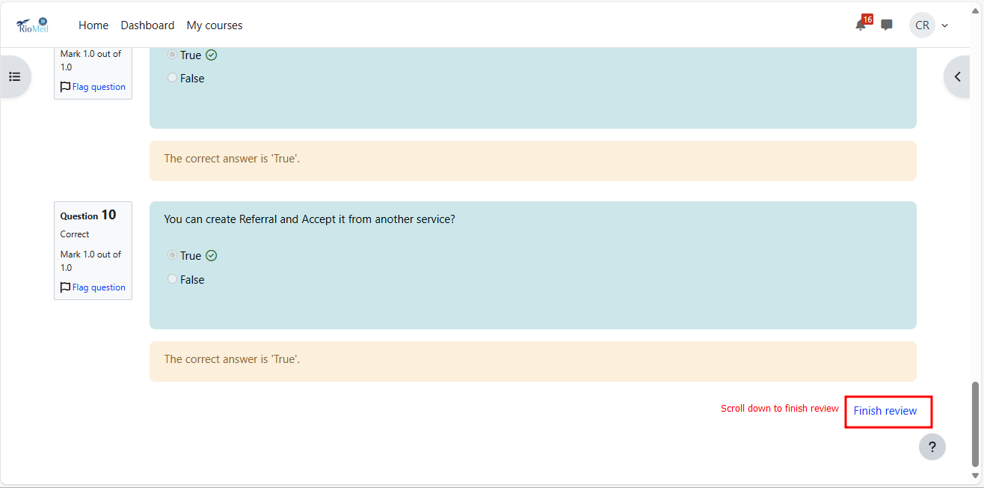
Finish Quiz Review

Slide 25
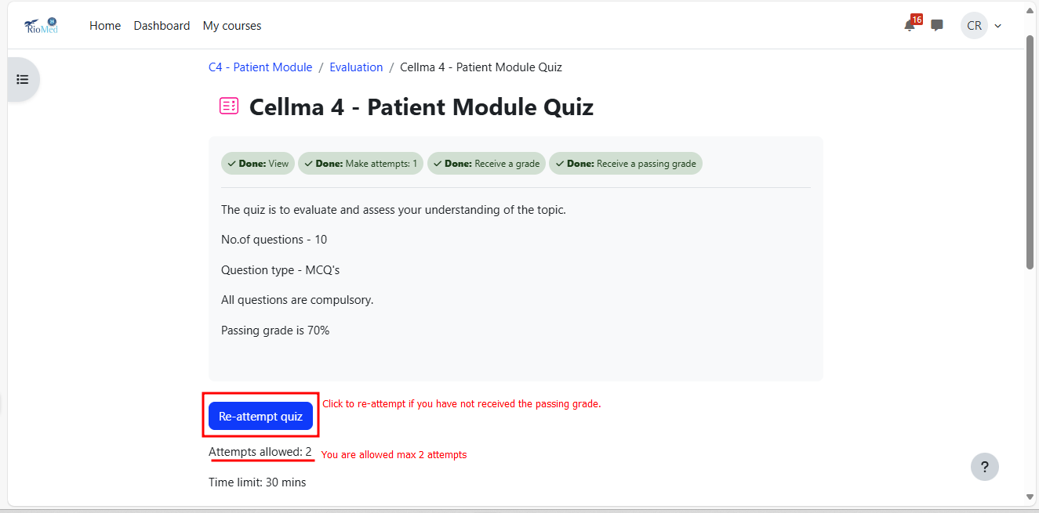
Re-attempt Quiz

Slide 26
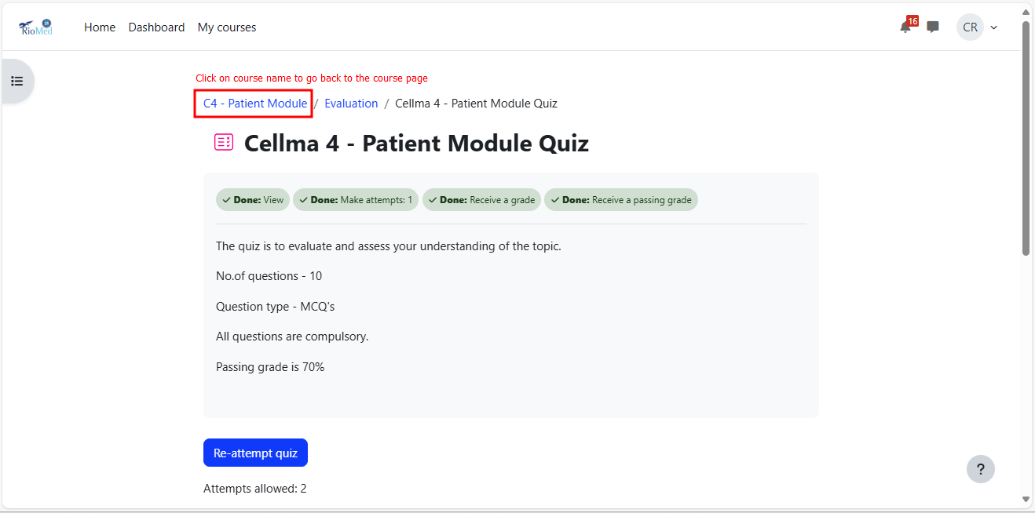
Go to Course Page

Slide 27
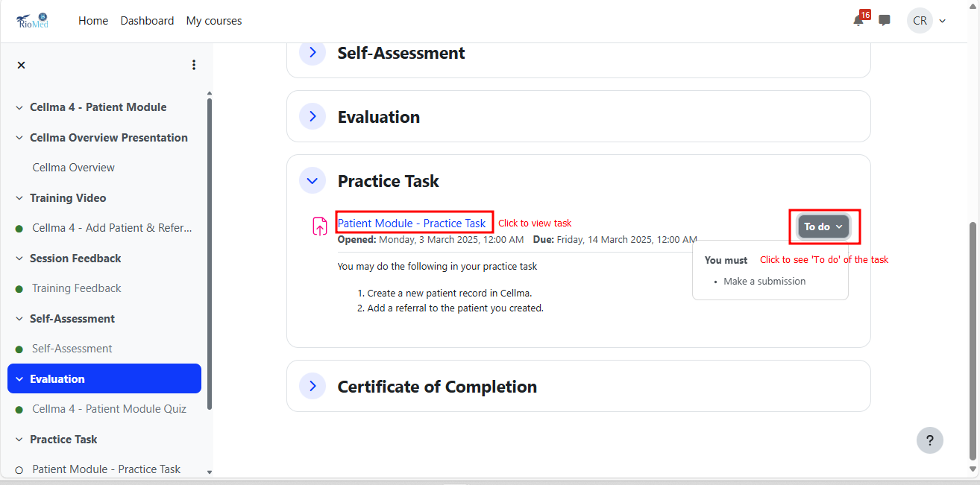
Practice Task

Slide 28
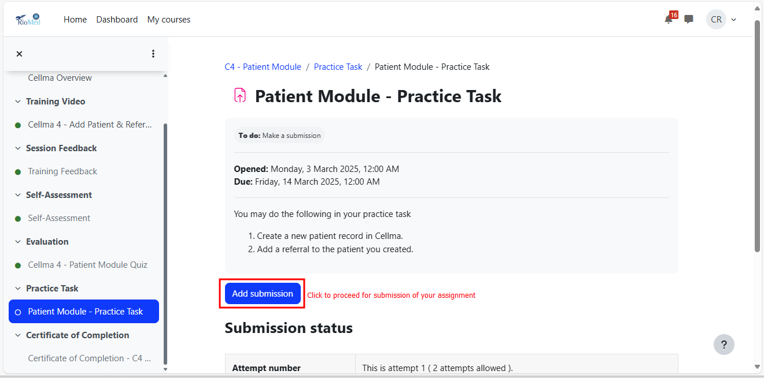
Task Submission

Slide 29
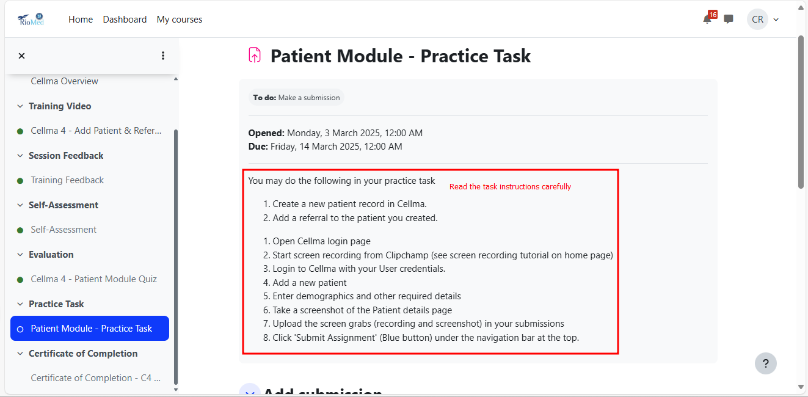
Task Instructions

Slide 30
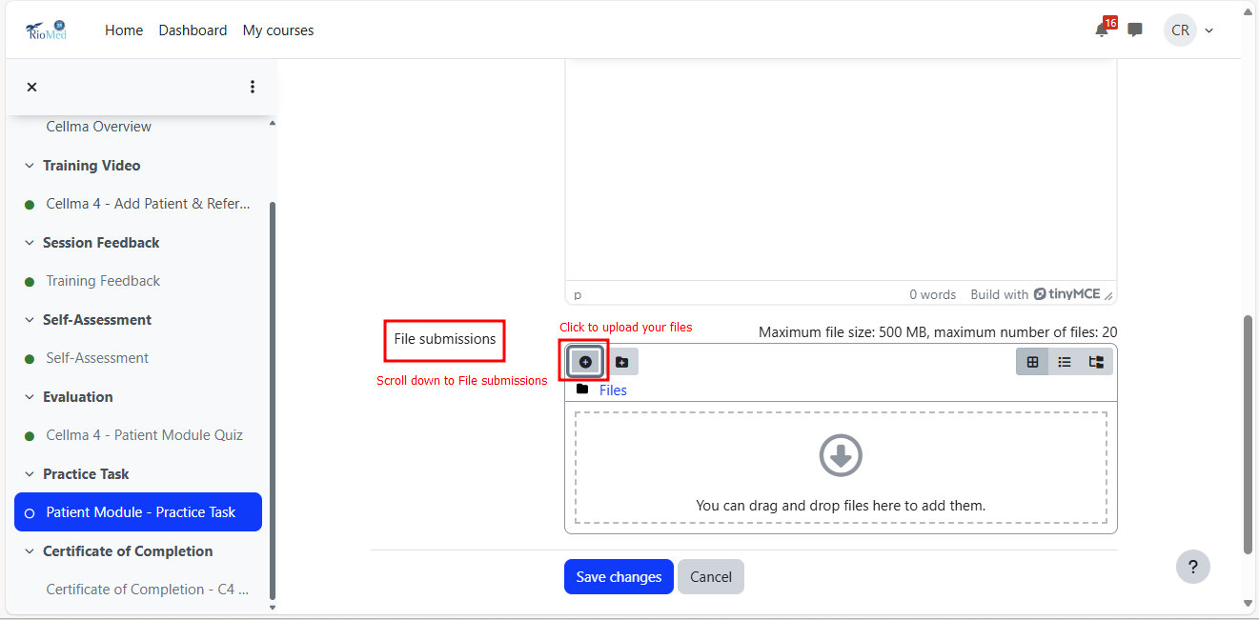
Task File Submission

Slide 31
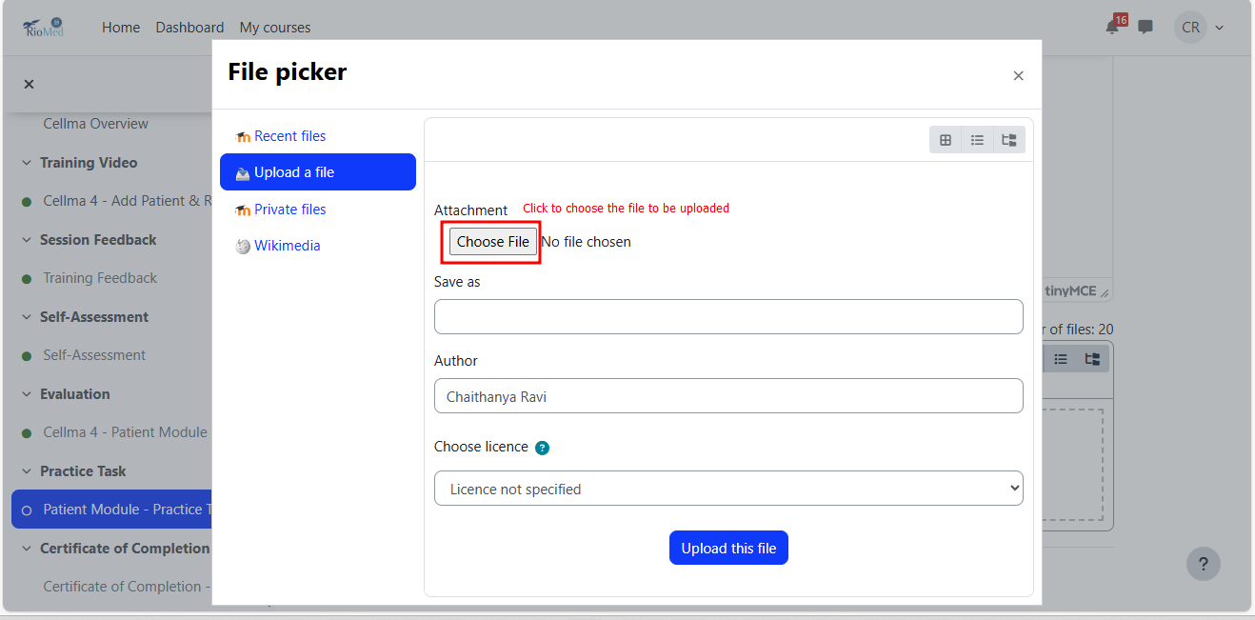
Task File Submission

Slide 32
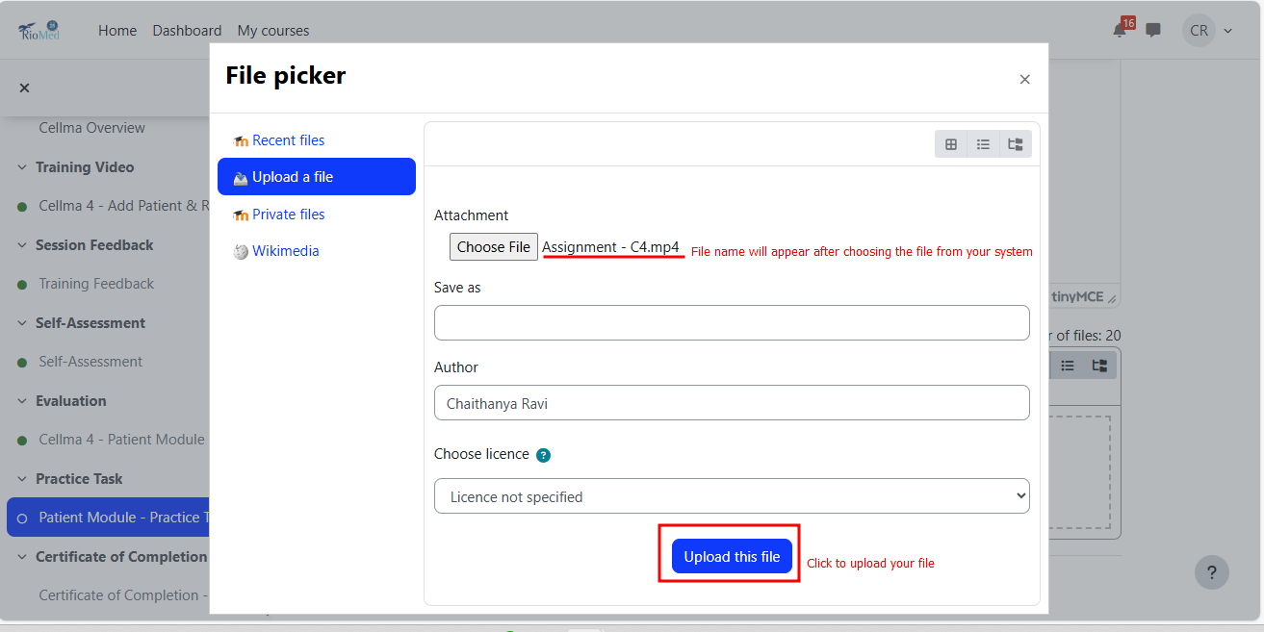
Task File Submission

Slide 33
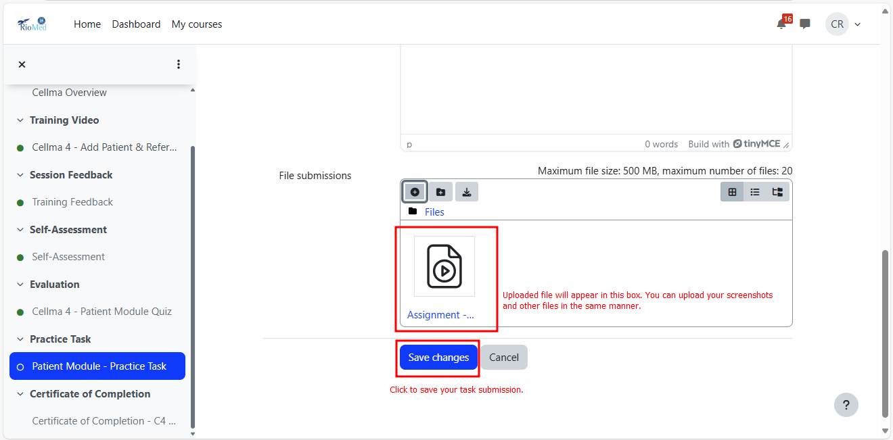
Save File Submission

Slide 34
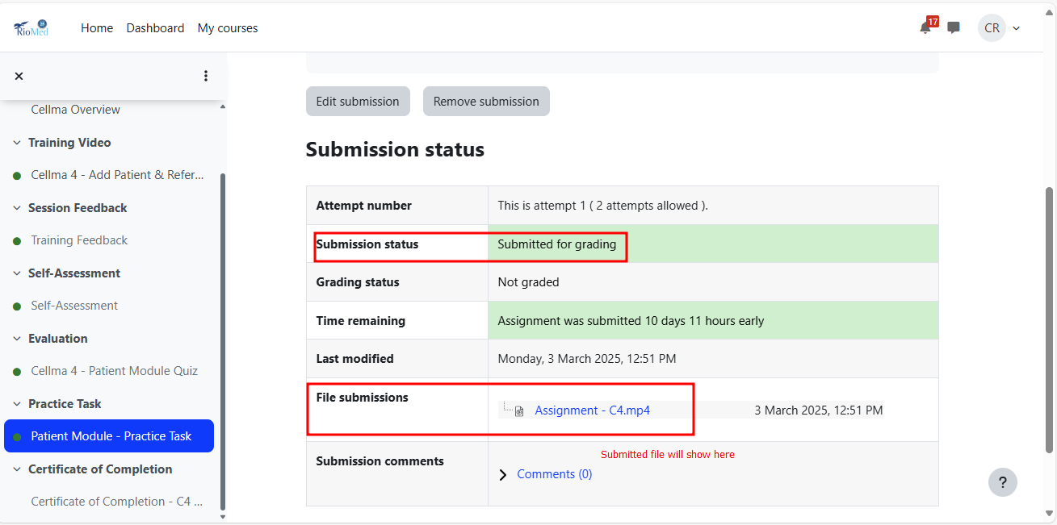
File Submission Status

Slide 35
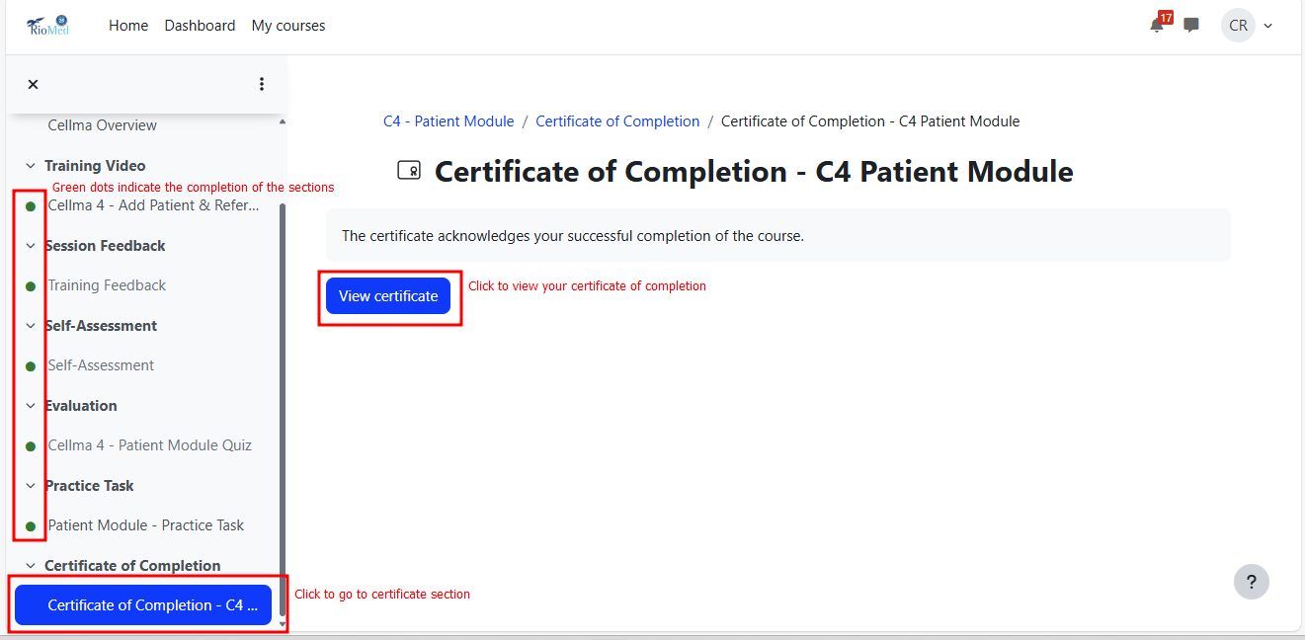
View your Certificate

Slide 36
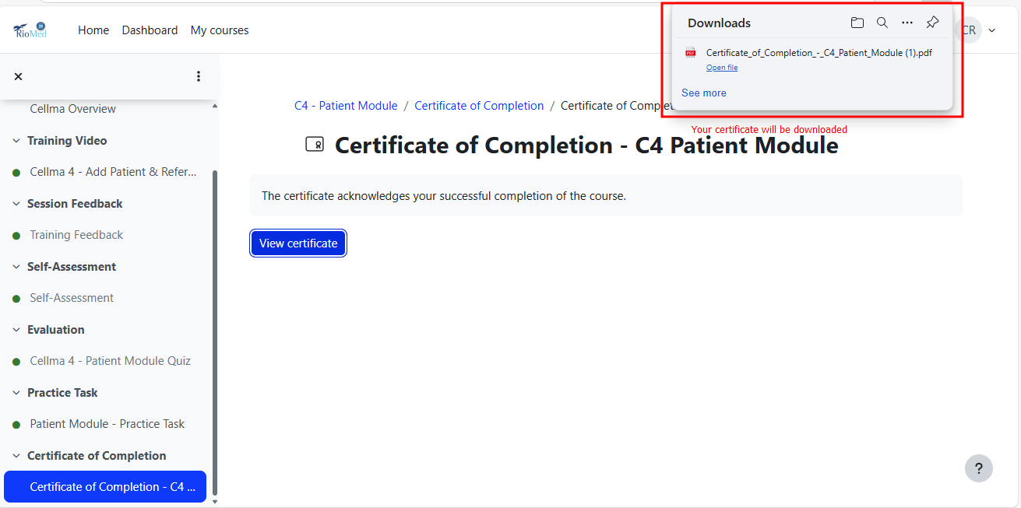
Download your Certificate

Slide 37
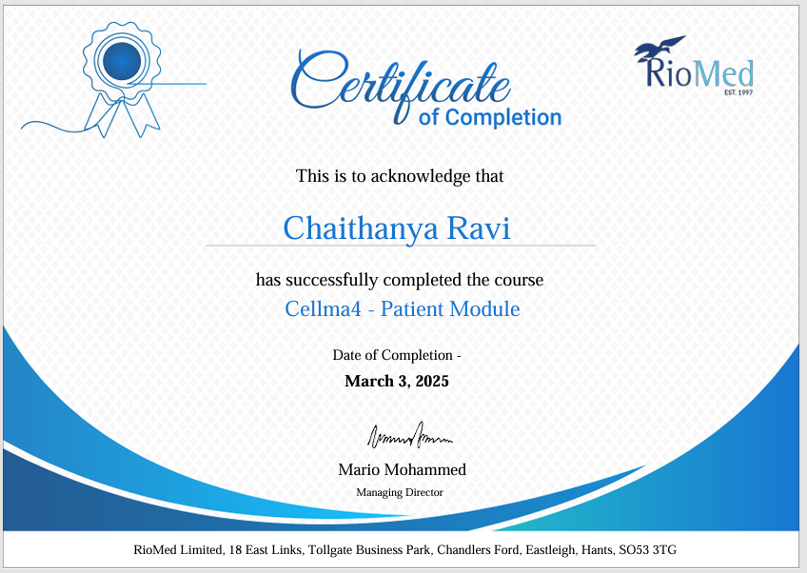
Certificate of Completion

Slide 38
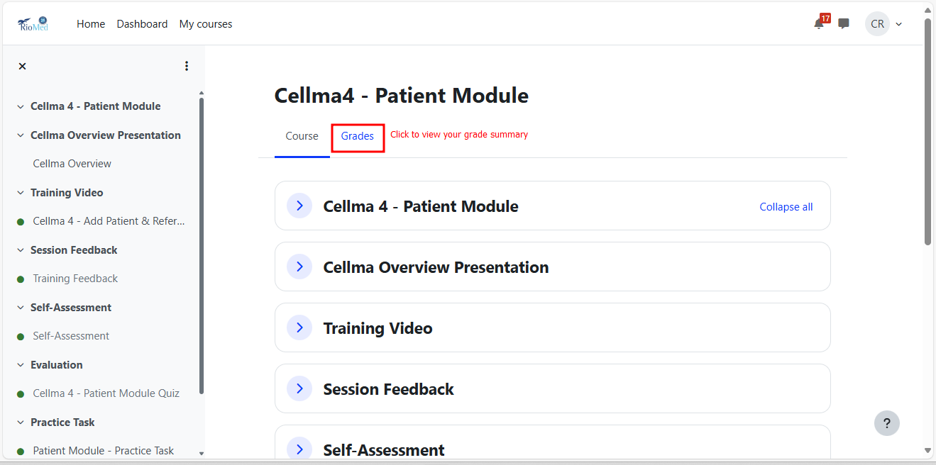
View your Grade Summary

Slide 39

All the Best!

